Slide 1
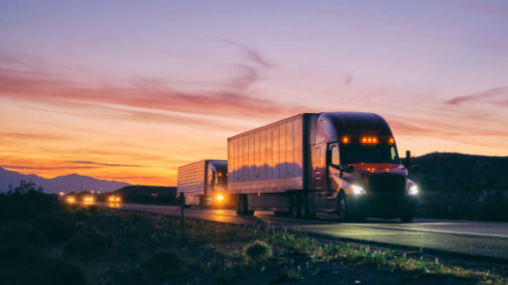
MIS 6346 BIG DATA ANALYTICS RISK ANALYSIS ON TRUCK FLEET DATA
GROUP 6:
Muhammad Ammar.
Udit Bhatia Divitha Mosuru. Subhash Chandra Gannamraju. Dimple Vyas.

Slide 2
BUSINESS OBJECTIVES
RISK ANALYSIS
Identifying dangerous commercial truck drivers nationwide
OFFER PERSONALISED SOLUTIONS BASED ON ANALYSIS
We will be using the Risk factor as “Mileage/Speed” to determine the risk factor for each driver.
RECOMMENDATIONS/ DECISION MAKING
To help the truck fleet Managers, to highlight the drivers who have the RiskFactor greater than or equal to 7.0.

Slide 3
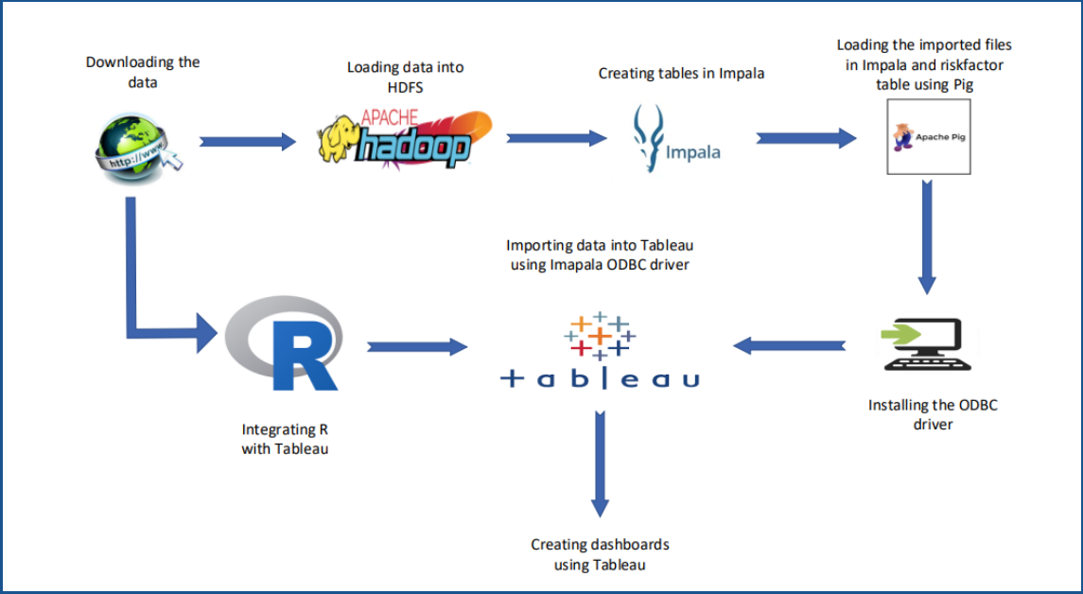
WORKFLOW

Slide 4
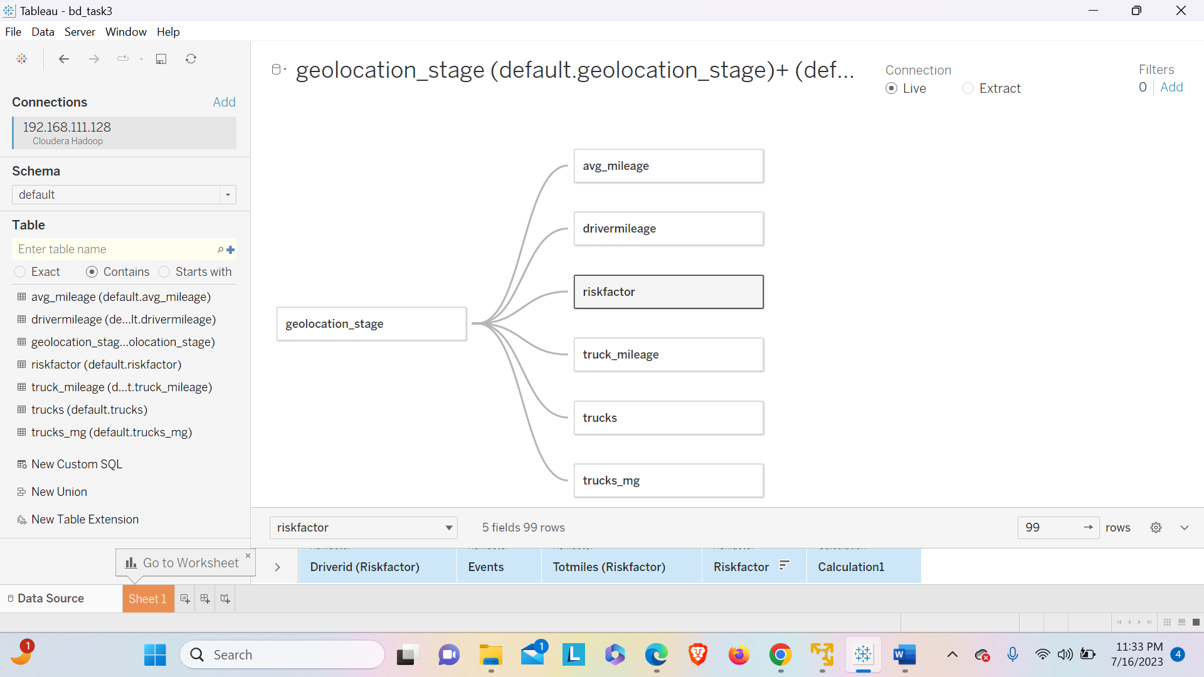
ABOUT THE DATA
The datasets used for this project has been retrieved from census.gov and other public internet resources.
Important Columns used from the tables that we considered for analysis in the datasets are:
1. Driver ID /Truck Id
2. Event
3. Risk Factor
4. State, city
5. Truck model
6. Velocity

Slide 5
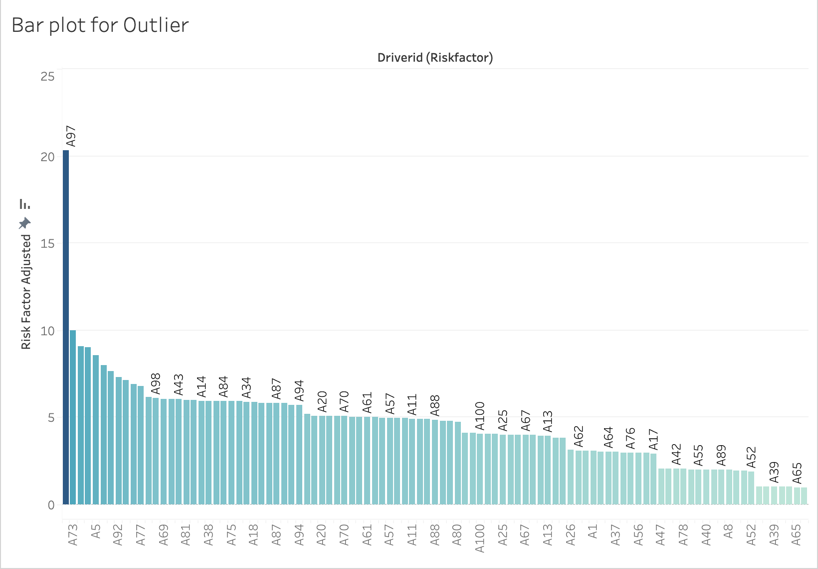
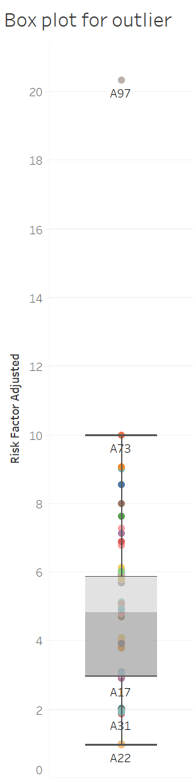
REMOVING THE OUTLIERS
INSIGHTS:
From the Bar plot for Risk Factor vs Driver ID, we can observe that driver A97 has the highest risk factor and has caused a lot of abnormal events. It poses as an outlier that can alter a lot of analysis by disturbing the plots.
SOLUTION:
Hence, we remove the outlier A97.

Slide 6
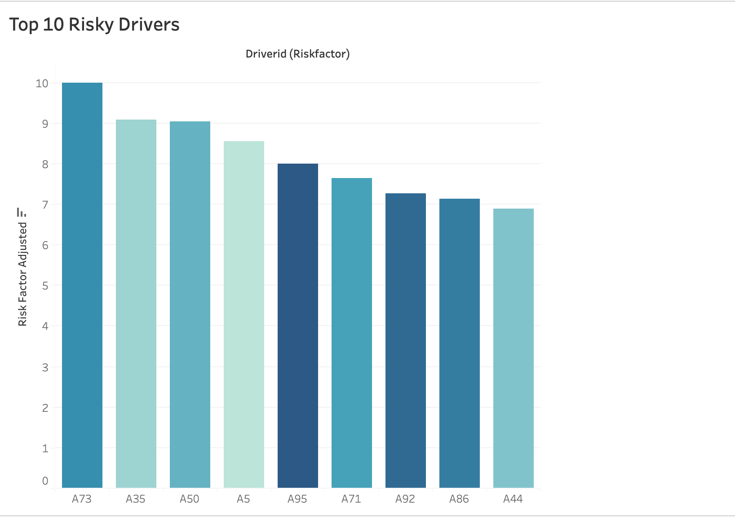
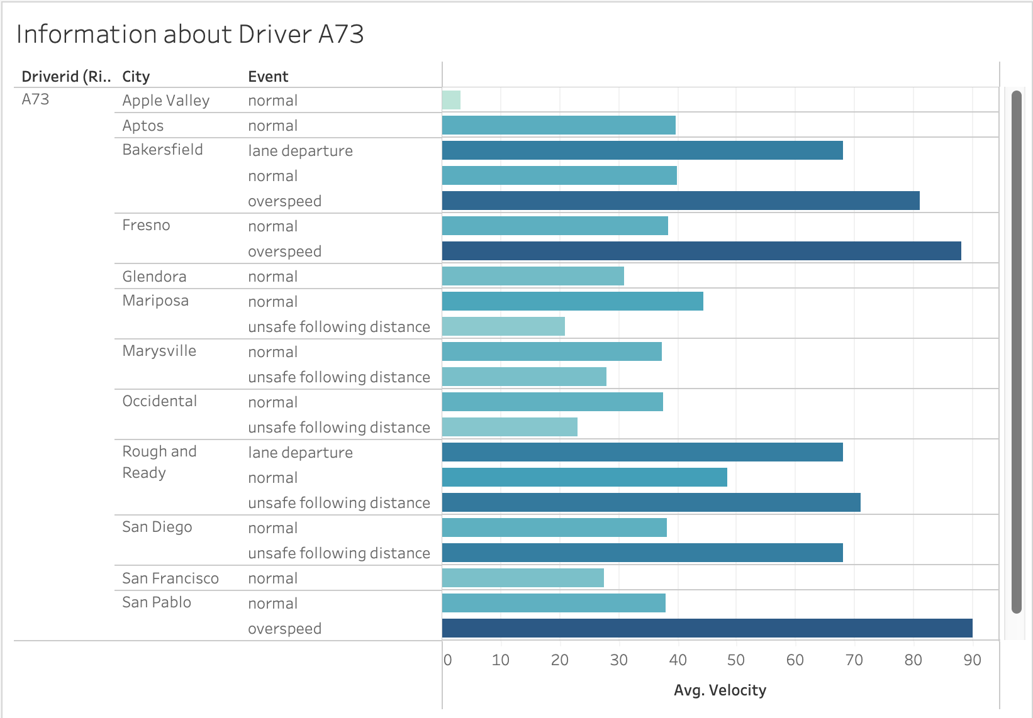
TOP 10 RISKY DRIVERS
INSIGHTS: From the above bar plot for the top 10 risky drivers, we can conclude that A73 has the highest risk factor and the “Information about Driver A73” graph shows that the highest risk is for “Overspeed” in “San Pablo” with an Average Velocity of 90.

Slide 7
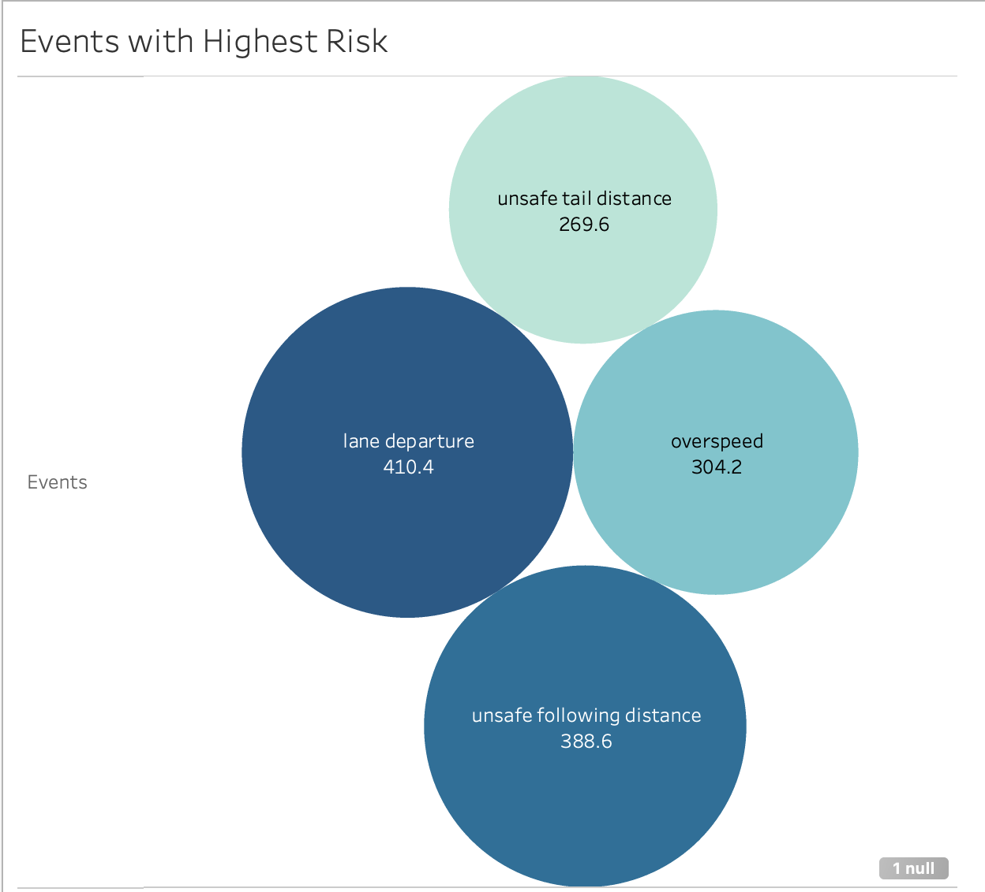
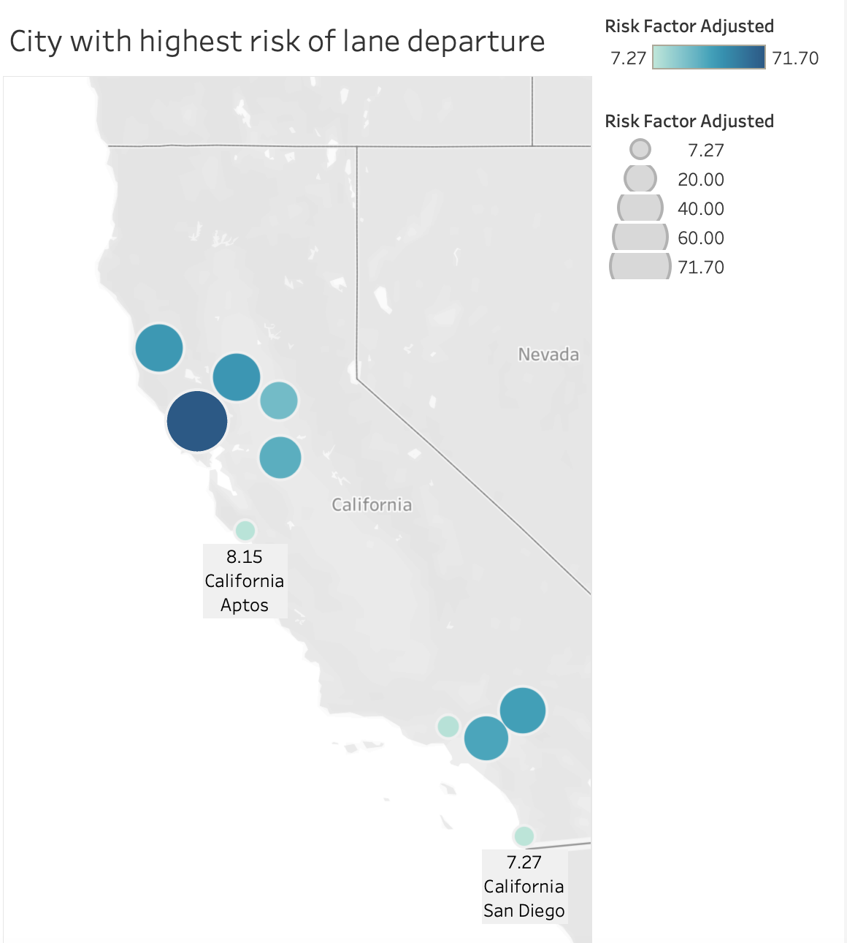
Geographical analysis
INSIGHTS:
From the Graph “Events with Highest Risk”, we can observe that the risk factor is highly dependent on four events which are:
Lane Departure
Unsafe following distance
Overspeed
Unsafe tail distance
Therefore, highest risk factor is “410.4” for event “Lane Departure”
GEOGRAPHICAL INSIGHTS:
From the above dashboard, we can conclude that for the city “Santa Rosa” in California, there is a highest risk of Lane Departure with a risk factor of “71.70”

Slide 8
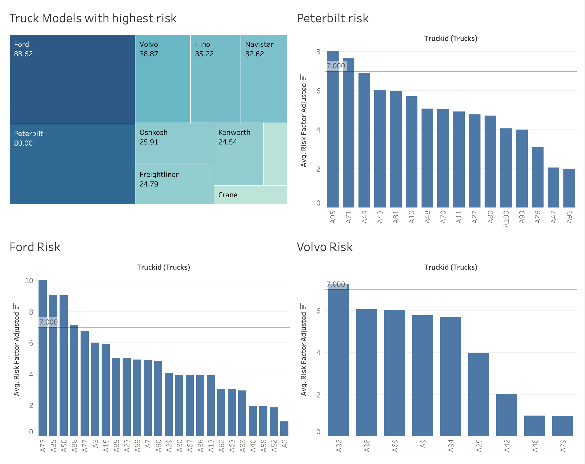
MODEL BASED ANALYSIS OF RISK FACTOR
INSIGHTS:
From this visualization dashboard “Truck models with highest risk factor” we can infer that for the model “Ford“ the risk factor is the highest being “88.62”, then for Peterbilt being “80.00” and Volvo’s risk factor is “38.87”
RECOMMENDATION:
By setting the threshold risk factor as 7.00, we identified the truckIDs in the top 3 risky models which can be discarded:
Highest number of models which are highly risky “Ford” i.e., 3 truck IDs {A73,A35,A50}. Similarly, there are 2 and 1 risky truck Ids in Peterbilt and Volvo respectively.

Slide 9
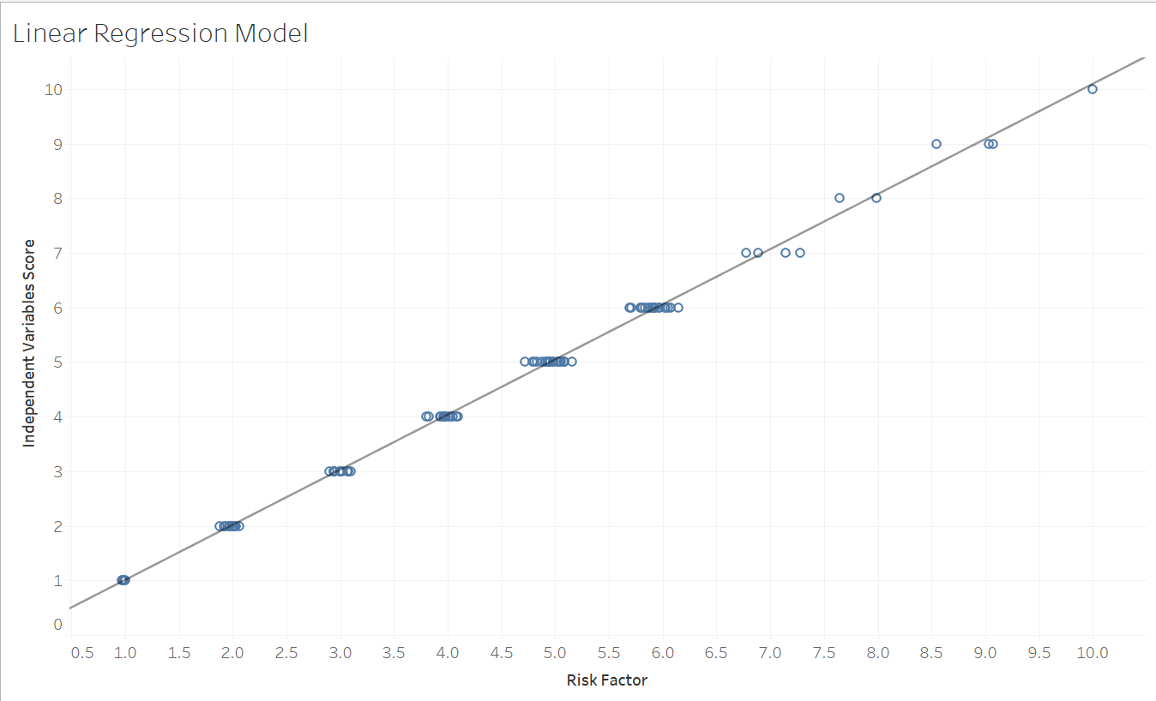
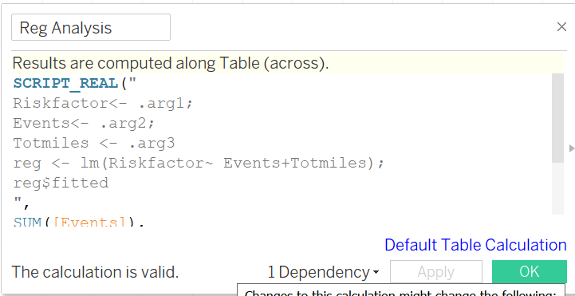
Risk Factor Forecasting Using R
Prediction:
From this visualization it is clear that dependent variables truck miles and events has direct correlation with risk factor. And risk is higher for higher prediction score.

Slide 10
Challenges
CONNECTING TO TABLEAU: We faced errors while connecting the database to tableau due to glitches in the database server.
POPULATING THE RISK FACTOR TABLE USING PIG SCRIPT: We struggled with executing the pig script provided for populating the riskfactor database due to our lack of experience with running Pig scripts.
TIME MANAGEMENT: Through this effort, new ideas were introduced. Before we could implement, we needed to familiarize ourselves with those notions. We overcame a significant difficulty in time management.

Slide 11
Conclusion
Truck Id A97 is an outlier, which indicates thorough research should be done by the concerned authorities to find out the reason for this abnormality.
Based on our study truck id with A73 is most likely to cause accidents. This information should be shared with other states and cities within California.
Risk factor for each driver also depends on the truck model with Ford truck posing maximum risk.
Lane departure is the highest risk causing event, thus using features like lane assist will help significant mitigation of risk.

